Slide 1

Writing a MATLAB program to compute 128-point DFT of the following sequence, you must firstly use DFT definition (directly computing DFT) to compute and use MATLAB function to test the result. Plot the two results
in one figure.
%using DFT definition compute
n=0:31;
x=sin(pi*n/4);
y1=zeros(1,128);
for k=1:128
y=0;
for n=1:32
y=y+x(n)*exp(-j*2*pi*(k-1)*(n-1)/128);
end
y1(k)=y;
end
k=1:128;
subplot(2,1,1)
plot(k,y1)
%using MATLAB function
n1=0:31;
x2=sin(pi*n1/4);
y2=fft(x2,128);
subplot(2,1,2)
plot(k,y2)

Slide 2
Using the function fir1 and window of Kaiser, design a linear-phase FIR lowpass filter meeting the following specifications: passband edge frequency=2kHz, stopband edge frequency=2.5kHz, passband ripple δp=0.005, stopband rippleδs=0.005, and sampling rate of 10kHz.Plot its gain and phase responses and check if it meets the specifications?
%using fir1 design FIR lowpass filter
[n,wn,beta,typ]=kaiserord([2000 2500],[1 0],[0.005 0.005],10000);
b=fir1(n,wn,kaiser(n+1,beta),'noscale');
[h,omega]=freqz(b,1,256);
subplot(2,1,1)
plot(omega/pi,20*log10(abs(h)));
xlabel('\omega/\pi'); ylabel('Gain, dB');
subplot(2,1,2)
plot(omega/pi,angle(h));grid
title('Phase Spectrum')
xlabel('\omega/\pi'); ylabel('Phase, radians')

Slide 3
.Design a Type 1 Chebyshev IIR lowpass filter meeting the specifications as below: sampling rate of 12kHz, passband edge frequency of 2.1kHz, stopband edge frequency of 2.7kHz, passband ripple of 0.6dB, and a minimum stopband attenuation of 45dB. Write down the exact expression for the transfer function generated. Does your design meet the specifications?
Fp=2100;Fs=2700;
Ft=12000;
Rp=0.6;Rs=45;
Wp=2*Fp/Ft;
Ws=2*Fs/Ft;
[N,Wn]=cheb1ord(Wp,Ws,Rp,Rs);
[B,A]=cheby1(N,Rp,Wn)

Slide 4
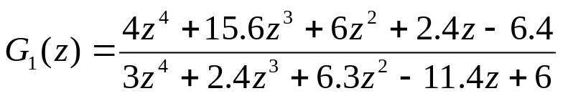
Using MATLAB determine the second-order factored form of the following z-transforms. And show their pole-zero plots. Then determine all possible ROCs of above z-transform.
num=[4 15.6 6 2.4 -6.4];
den=[3 2.4 6.3 -11.4 6];
[sos,G]=tf2sos(num,den)
[z,p,k]=tf2zp(num,den)
zplane(z,p);

Slide 5
Write a MATLAB program to compute and display the rational z-transform from its zero,poles and gain constant. If the DTFT of the causal system exists, try to plot it's magnitude and phase spectra. Using this program to determine the rational form of a z-transform whose zero are at ξ1= 1.2, ξ2= 2.3-j0.5, ξ3= -0.4+j0.2, ξ4= -0.4-j0.2,ξ5= 2.3+j0.5; the ploes are at λ1= 0.5, λ2= -0.75+j0.2, λ3= 0.6+j0.7, λ4= 0.6-j0.7,λ5= -0.75-j0.2; and the gain constant k is 2.1.
z=input('input the zeros=');
p=input('input the ploes=');
g=input('input the gain constant=');
[num,den]=zp2tf(z',p',g);
w = 0:pi/(255):pi;
h=freqz(num,den,w);
subplot(2,1,1)
plot(w/pi,abs(h));grid
title('Magnitude Spectrum')
xlabel('\omega/\pi'); ylabel('Magnitude')
subplot(2,1,2)
plot(w/pi,angle(h));grid
title('Phase Spectrum')
xlabel('\omega/\pi'); ylabel('Phase, radians')
input the zeros=[1.2 2.3-i*0.5 -0.4+i*0.2 -0.4-i*0.2 2.3+i*0.5]
input the ploes=[0.5 -0.75+i*0.2 0.6+i*0.7 0.6-i*0.7 -0.75-i*0.2]
input the gain constant=2.1

Slide 6

Design an FIR hanning digital lowpass filter with the following specifications: passband edge frequency 0.3 ,stopband edge frequency 0.4 , stopband attenuation 40 dB. Please plot frequency-magnititude response and check if your design fit the specification。
Wp=0.3*pi;Ws=0.4*pi;
Rs=40;
dw=abs(Wp-Ws);
M=ceil(3.11*pi/dw);
Wc=(Wp+Ws)/(2*pi);
n=-M:1:M;
h=Wc*sinc(Wc*n);;
Wn=hann(2*M+1);
h1=h.*Wn';
[H,w]=freqz(h1,1,512);
plot(w/pi,20*log10(abs(H)));
%or using b=fir1(N,Wc,hann(N+1));
M=3.11*pi/dw;
N=ceil(2*M+1);
Wc=(Wp+Ws)/(2*pi);
h1=fir1(N,Wc,hann(N+1));

Slide 7
Given a signal
when using a sampling frequency f_{T}= 20KHz, plot the magnitude and phase spectrum of the sampled sequence(given length-64).
syms t;
x=sin(0.1*pi*t)+2*cos(0.3*pi*5*t)+3*sin(0.5*pi*t);
ft=20000;
n=1:64;
y=subs(x,t,n/ft);
subplot(2,1,1)
[h,w]=freqz(y,1);
plot(w/pi,abs(h));
title('Magnitude spectrum of the sampled samples')
xlabel('\omega/\pi'); ylabel('Magnitude')
subplot(2,1,2)
plot(w/pi,angle(h));
title('Phase spectrum of the sampled samples')
xlabel('\omega/\pi'); ylabel('Phase')

Slide 8
Using the function fir1 and window of Hamming, design a linear-phase FIR lowpass filter meeting the following specifications: passband edge frequency=2kHz, stopband edge frequency=2.3kHz, passband ripple δp=0.002, stopband rippleδs=0.002 and sampling rate of 20kHz.Plot its gain and phase responses and check if it meets the specifications?
Fp=2000;Fs=2300;
b1=0.002;b2=0.002;
Ft=20000;
Wp=2*pi*Fp/Ft;
Ws=2*pi*Fs/Ft;
Wc=(Wp+Ws)/(2*pi);
m=3.22*pi/abs(Wp-Ws);
N=ceil(2*m+1);
h=fir1(N,Wc); %h = fir1(N,Wn,WIN)不加win则默认用Hamming window
[H,w]=freqz(h,1,512);
plot(w/pi,20*log10(abs(H)));

Slide 9
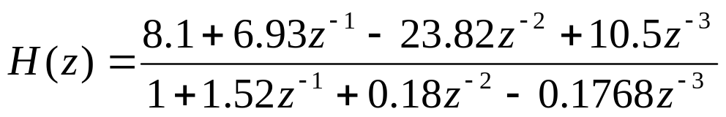
Using MATLAB program to Determine all possible ROCs of the following z-Transforms, and describe the type of their inverse z-Transforms(left-sided, right-sided, two-sided sequences) associated with each of the ROCs.
num=[8.1 6.93 -23.82 10.5];
den=[1 1.52 0.18 -0.1768];
[z,p,k]=tf2zp(num,den);
zplane(z,p);
%对于LTI IIR滤波器传递函数收敛域 为|z|>2.3452 right-sided(causal)sequence
z =
-2.3452
0.7896
0.7000
p =
-1.2681
-0.5200
0.2681
k =
8.1000

Slide 10
design an IIR butterworth digital lowpass filter with the following specifications: sampling rate of 7kHz, passband edge frequency of 1.05kHz, stopband edge frequency of 1.4kHz, passband ripple of 0.4dB, and a minimum stopband attenuation of 30dB. plot frequency-magnitude and check if your design fits the specification.
Fp=1050;Fs=1400;Ft=7000;
Rp=0.4;Rs=30;
Wp=2*Fp/Ft;Ws=2*Fs/Ft;
[N,Wn] = buttord(Wp, Ws, Rp, Rs);
[b,a] = butter(N,Wn);
[h,omega] = freqz(b,a,256);
gain = 20*log10(abs(h));
plot (omega/pi,gain);grid;
xlabel('\omega/\pi'); ylabel('Gain, dB');
title('IIR Butterworth Filter');

Slide 11
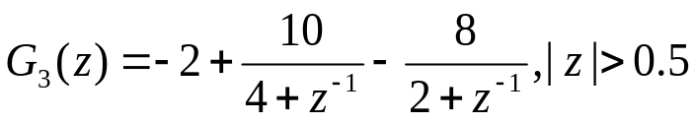
Write a MATLAB program to compute the first L samples of the inverse of rational z-transforms where the value of L is provided by the user through the command input. Using this program to compute and plot the first 50 samples of the inverse of following G(z). Use the command stem for plotting the sequence generated by the inverse transform.
L=input('input the L=');
r=[10/4 -8/2];
p=[-1/4 -1/2];
k=-2;
[B,A]=residuez(r,p,k);
[h t]=impz(B,A,L);
stem(t,h);

Slide 12

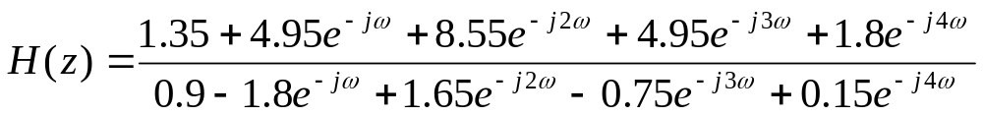
Try to give a program to evaluate the following DTFT in the range :
Then run the Program and compute the real and imaginary parts of the DTFT, and the magnitude and phase spectra. Is the DTFT a periodic function of w? If it is, what is the period?. Can you explain the jump in the phase spectrum? The jump can be removed using the MATLAB command "unwrap". Evaluate the phase spectrum with the jump removed
num = input('Numerator coefficients = ');
den = input('Denominator coefficients = ');
% Compute the frequency response
w = 0:pi/(k-1):pi;
h = freqz(num, den, w);
% Plot the frequency response
subplot(2,2,1)
plot(w/pi,real(h));grid
title('Real part')
xlabel('\omega/\pi'); ylabel('Amplitude')
subplot(2,2,2)
plot(w/pi,imag(h));grid
title('Imaginary part')
xlabel('\omega/\pi'); ylabel('Amplitude')
subplot(2,2,3)
plot(w/pi,abs(h));grid
title('Magnitude Spectrum')
xlabel('\omega/\pi'); ylabel('Magnitude')
subplot(2,2,4)
plot(w/pi,angle(h));grid %unwrap(angle(h))
title('Phase Spectrum')
xlabel('\omega/\pi'); ylabel('Phase, radians')

Slide 13
design an elliptic IIR lowpass filter with the following specifications: sampling rate of 7kHz, passband edge frequency of 1.05kHz, stopband edge frequency of 1.4kHz, passband ripple of 0.4dB, and a minimum stopband attenuation of 30dB. plot frequency-magnitude and check if your design fits the specification
Ft=7000;Fp=1050;Fs=1400;
Rp=0.4;Rs=30;
Wp=2*Fp/Ft;Ws=2*Fs/Ft;
[N, Wn] = ELLIPORD(Wp, Ws, Rp, Rs);
[B,A] = ELLIP(N,Rp,Rs,Wn);
[h,w]=freqz(B,A,256);
gain=20*log10(abs(h));
plot(w/pi,gain);
xlabel('\omega/\pi'); ylabel('Gain, dB');
title('Ellipitc IIR lowpass filter');

Slide 14
Design using the windowed Fourier series approach a linear-phase FIR lowpass filter with the following specifications: passband edge at 3.1rad/sec, stopband edge at 5 rad/sec, maximum passband attenuation of 0.2dB, minimum stopband attenuation of 45dB, and a sampling frequency of 40rad/sec. Use the window of Hanning to perform it , then show the impulse response coefficients and plot the gain response of the designed filters.
Wp=3.1*2*pi/40;Ws=5*2*pi/40;
Rp=0.2;Rs=45;
dw=abs(Wp-Ws);
M=ceil(3.11*pi/dw);
Wc=(Wp+Ws)/(2*pi);
n=-M:1:M;
h=Wc*sinc(Wc*n);;
Wn=hann(2*M+1);N=2*M+1;
b=fir1(N,Wc,hann(N+1));
h1=h.*Wn';
[H,w]=freqz(b,1,512);
plot(w/pi,20*log10(abs(H)));

Slide 15
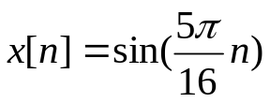

Generate and plot a sequence , with . Compute the energy of the sequence.
n=0:50;
x=sin(5*pi*n/16);
stem(n,x); %或者如下
syms n1; %x1=x’
x1=sin(5*pi*n1/16).^2; %y=x*x1
y=symsum(x1,n1,0,50);
y1=double(y)
y1 =
25.5449

Slide 16
Using MATLAB to determine the lowest order of a digital IIR lowpass filter of all four types(Butterworth, Type1 Cheby, Type2 Cheby, elliptic). The specifications are as following: sampling rate of 12kHz, passband edge frequency of 2.1kHz, stopband edge frequency of 2.7kHz, passband ripple of 0.6dB, and a minimum stopband attenuation of 45dB. Comment on your results.
Ft=12000;
Fp=2100;Fs=2700;
Rp=0.6;Rs=45;
Wp=2*Fp/Ft;
Ws=2*Fs/Ft;
N1=buttord(Wp,Ws,Rp,Rs);
disp('butterworth');N1
N2=cheb1ord(Wp,Ws,Rp,Rs);
disp('Type1 cheby');N2
N3=cheb2ord(Wp,Ws,Rp,Rs);
disp('Type2 cheby');N3
N4=ellipord(Wp,Ws,Rp,Rs);
disp('elliptic');N4
Butterworth：19
Type1 cheby：8
Type2 cheby：8
Elliptic :5

Slide 17


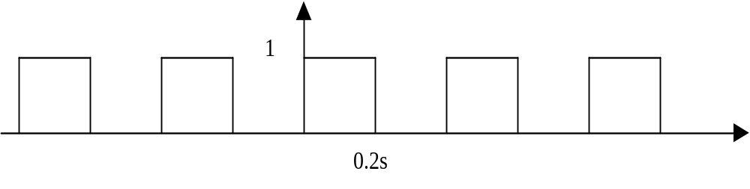
Consider the following periodic signal as below, which is sampled to get 512-points discrete-time signal The sampling period is second. Determine the sampling type of the process. Sketch the time domain and frequency domain plot of continuous time and sampled signal. Analysis the sampling process.
t=0:0.01:1;
x=square(2*pi*t/0.4);
subplot(2,2,1)
plot(t,x,'r');axis([0 1 0 2]);%原始波形
n=0:511;
T=0.02;
y=square(2*pi*n*T/0.4);
hold on
stem(n/50,y);axis([0 1 0 2]);%采样后波形
hold off
title('原始及采样信号时域波形');
[h1,w1]=freqz(x,1);
h=fft(y,256);
subplot(2,2,2)
plot(w1/pi,abs(h1),'r');%原始信号频域波形
title('原始信号频域波形');
axis([0 1 0 max(abs(h1))]);
subplot(2,2,3)
n=0:255;
plot(n,abs(h));%采样后频域波形
title('采样后频域波形');

Slide 18


Writing a MATLAB program to compute the linear convolution of two length-N sequences. Using this program to determine the following pair of sequences:
And plot the result sequence.
n=0:10;
g=cos(0.2*pi*n);
h=3.^n;
y=conv(g,h);
n1=0:length(y)-1;
stem(n1,y);

Slide 19


Writing a MATLAB program to compute the circular convolution of two length-N sequences via the DFT-based approach. Using this program to determine the following pair of sequences:
g[n]={7, 4, -9, 0, 2, -5}, h[n]={1, -1, 2, 0, 10, 5} or
And plot the result sequence.
x1=[7 4 -9 0 2 -5];
x2=[1 -1 2 0 10 5];
L=length(x1);
y=zeros(1,L);
x2tr = [x2(1) x2(L:-1:2)];
for k = 1:L,
sh = circshift(x2tr', k-1)';
h = x1.*sh;
y(k) = sum(h);
end
disp(y);
n=0:length(x1)-1;
stem(n,y);
%n=0:15;
%x1=exp(j*pi*n/4);
%x2=2.^n;

Slide 20
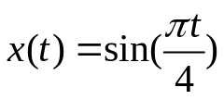

Consider the following signal , which is sampled to get discrete-time signal The sampling period is second. Determine the sampling type of the process. Sketch the time domain and frequency domain plot of continuous time and sampled signal. Analysis the sampling process.
t=0:0.01:10;
x=sin(pi*t/4);
subplot(2,2,1)
plot(t,x,'r');axis([0 10 -1.5 1.5]);%原始信号时域波形
n=0:128;
T=0.5;
y=sin(pi*n*T/4);
hold on
stem(n/2,y);axis([0 10 -1.5 1.5]);%采样后时域波形
hold off
title('原始及采样后时域波形');
[h1,w1]=freqz(x,1);
h=fft(y,256);
subplot(2,2,2)
plot(w1/pi,abs(h1),'r');%原始信号频域波形
title('原始信号频域波形');
axis([-0.5 0.5 0 max(abs(h1))]);
subplot(2,2,3)
n=0:255;
plot(n,abs(h));%采样后频域波形
title('采样后频域波形');

Slide 21
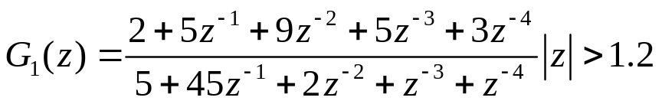
Write a MATLAB program to determine the partial-fraction expansion of the z-transform listed the following G(z) and then determine their inverse z-transforms.
num=[2 5 9 5 3];
den=[5 45 2 1 1];
[r,p,k]=residuez(num,den);
r1=[r(2) r(3)];p1=[p(2) p(3)];
[b,a]=residuez(r1,p1,0);
h=impz(num,den); %参考书P444

Slide 22
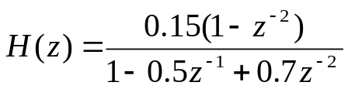
Write a MATLAB program to compute and plot the frequency response of a causal LTI discrete-time system with a transfer function given by
for 0≤ω≤π.What type of filter does it represent(lowpass, highpass, bandpass, bandstop or allpass)?
num=[0.15 0 -0.15];
den=[1 -0.5 0.7];
[h,w]=freqz(num,den);
plot(w/pi,abs(h));%从图看似乎是bandpass

Slide 23

Write a MATLAB program to compute and plot the response of input as and a causal finite-dimensional discrete-time system characterized by a difference equation of the following form:
Generate and plot the first 31 samples of the sinusoidal response of the system.
num=[1.8 0.34 -1.32 -0.86];
den=[1 0.3 0.5 -0.72];
n=0:30;
x=cos(0.2*pi*n);
y=filter(num,den,x);
subplot(2,1,1)
stem(n,y);
title('输出信号');
subplot(2,1,2)
[h,T]=impz(num,den,31);
stem(T,h);
title('系统响应');

Slide 24

Write a MATLAB program to compute and plot the response of input as
and a causal finite-dimensional discrete-time system characterized by a difference equation of the following form:
Generate and plot the first 41 samples of the the response of the system.
num=[0.8 -0.44 0.36 0.02];
den=[1 0.7 -0.45 -0.6];
n=0:15;
x=ones(1,16);
y=filter(num,den,x);
subplot(2,1,1)
stem(n,y);
title('输出信号');
subplot(2,1,2)
[h,T]=impz(num,den,41);
stem(T,h);
title('系统响应');

